Slide 1
Digital Portfolio
STUDENT NAME: Madhu prattika .S
REGISTER NO AND NMID: 2428C0482
DEPARTMENT: B.Sc AI & ML
COLLEGE: KPR College of Arts Science and Research, Bharathiar University

Slide 2
PROJECT TITLE
Nurse Professional Skills Portfolio

Slide 3


AGENDA
Problem Statement
Project Overview
End Users
Tools and Technologies
Portfolio design and Layout
Features and Functionality
Results and Screenshots
Conclusion
Github Link
3/21/2024 Annual Review

Slide 4

PROBLEM STATEMENT
Nurses often lack a structured system to record skills and certifications.
Important achievements and experiences remain scattered or undocumented.
Difficulty arises in showcasing competencies during evaluations or job applications.
This limits career growth and creates challenges in meeting professional standards.

Slide 5

PROJECT OVERVIEW
Provides a structured system for nurses to record skills, certifications, and achievements.
Helps in showcasing competencies for evaluations, promotions, and job opportunities.
Encourages continuous learning and professional growth through organized tracking.
Supports healthcare organizations in assessing skills, compliance, and workforce readiness.

Slide 6

WHO ARE THE END USERS?
Nurses – to track and show their skills.
Nursing students – to build their career portfolio.
Hospitals/healthcare employers – to check staff skills and growth.
Regulators – to verify standards and compliance.

Slide 7

TOOLS AND TECHNIQUES
HTML5 – for structuring the portfolio web pages.
CSS3 (3D Effects, Gradients) – for styling and visual enhancements.
JavaScript (Interactivity) – to add dynamic features and user interactions.
GitHub Pages (Deployment) – to host and share the portfolio online.
VS Code (Development) – as the code editor for building and managing the project.

Slide 8
POTFOLIO DESIGN AND LAYOUT
Modern, clean layout with structured sections for smooth readability
Sections: Home, About Me, Skills/Events Showcase, Projects/Achievements, Contact
Event-themed colors: Gold (highlights/headings) & Dark Blue (backgrounds/buttons)
Interactive 3D hover effects on cards and sticky navigation bar for smooth scrolling
Responsive design with glassmorphism cards, floating elements, and animated skill meters
8

Slide 9
FEATURES AND FUNCTIONALITY
Modern, professional design with structured sections and readable layout
Interactive 3D hover and tilt effects on cards, hero, and project elements
Glassmorphism cards with floating background elements for visual depth
Sticky navigation bar, smooth scrolling, and responsive design for all devices
Animated skill meters and a contact form for showcasing skills and easy communication

Slide 10
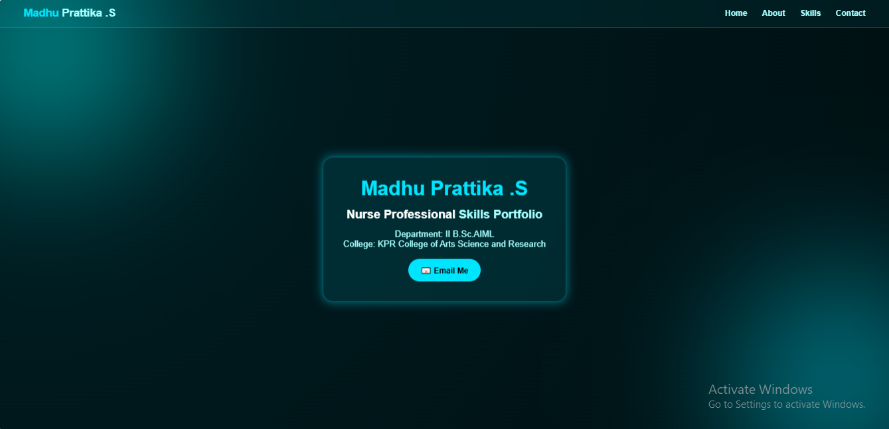
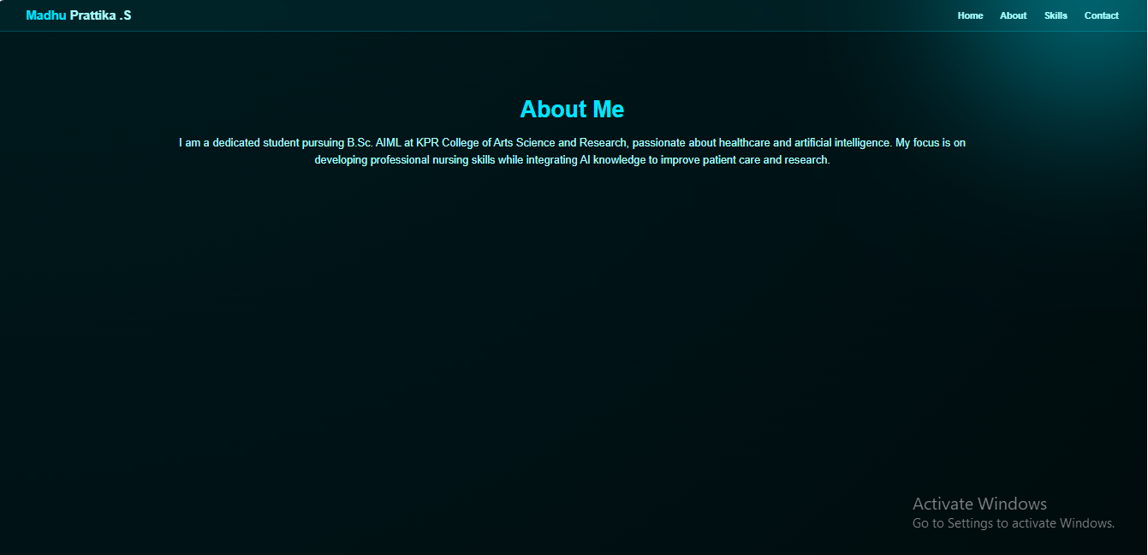

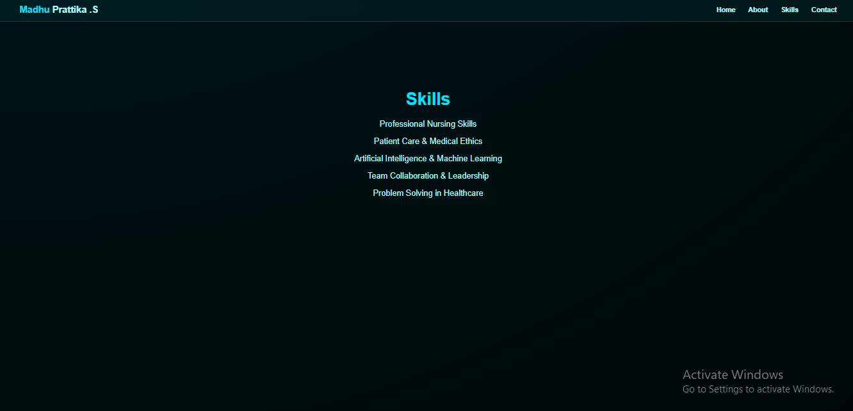
RESULTS AND SCREENSHOTS
Results:
Professional, visually appealing portfolio showcasing skills, projects, and achievements
Interactive and engaging experience with 3D hover effects and animations
Smooth navigation and easy contact via sticky navbar and integrated form
Screenshot:
3/21/2024 Annual Review
10

Slide 11
CONCLUSION
The portfolio presents a modern and professional platform to showcase my skills and achievements.
Interactive 3D effects and animations make the portfolio engaging and visually appealing.
Structured sections ensure smooth readability and highlight academic and professional details.
Responsive design with smooth navigation improves accessibility across all devices.
Serves as an effective tool for career opportunities, networking, and future growth.
11

Slide 12
Git hub Link: Portfolio Repository: https://github.com/madhu-aibytes/my-portfolio.git

